Slide 1
Introduction to Socket Interface
August 30, 2023

Slide 2
Agenda
Introduction to Socket Interface
Socket Interface Commands
Calling sequence to setup a TCP connection
UDP service calling sequence
Configuration of transport services
getsocket() | send() or write()
bind() | receive() or read()
listen() | sendto()
accept() | recvfrom()
connect()

Slide 3
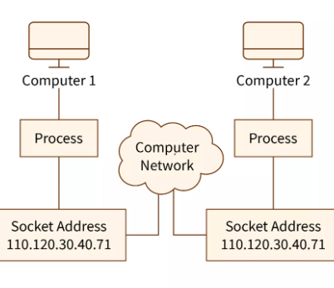
Socket Interface
Socket interface defines the command set that applications can access the services of TCP/IP communication protocol between two endpoints, facilitating seamless exchange of data over a network.

Slide 4
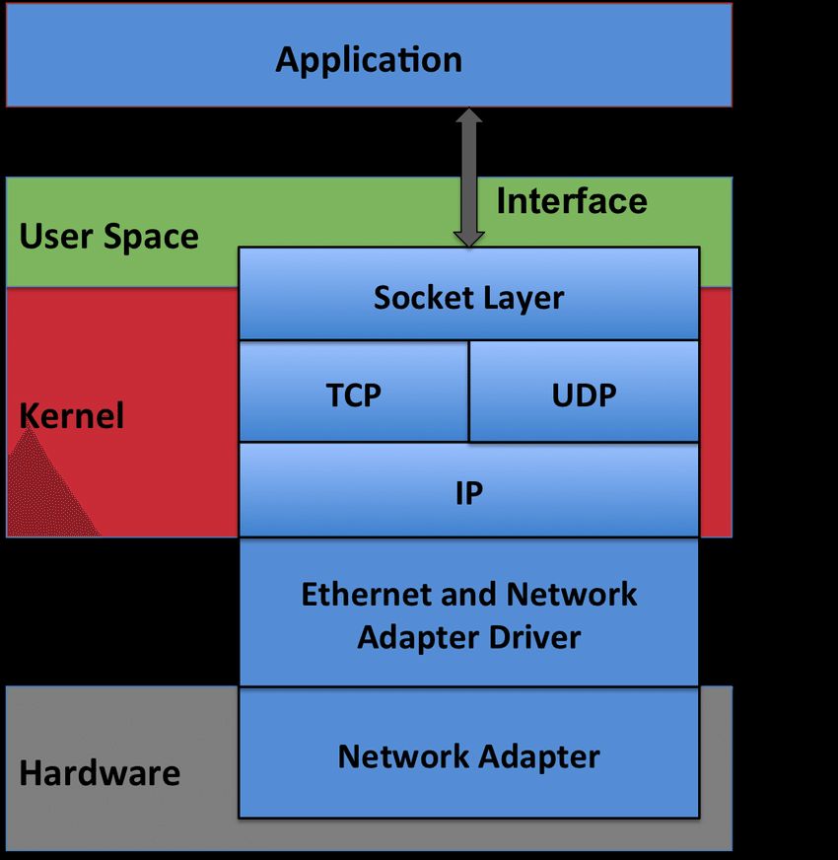
Socket Interface: Architecture Prospective
Located between application layer and transport layer.
Provide an uniform interface for TCP, UDP and IP protocols.
Allow users to select their transport services.

Slide 5
Communication end point: A Socket
A memory block in the kernel to record the communication user profile and the state of current communication.
Application process refers to the socket during the communication with its partner.
Each socket is configured for a certain transport service.

Slide 6
Configure transport service
int getsocket (int domain, int type, int protocol);
Field | Constant | Purpose
domain | AF_INET | Use IPv4 addresses
 | AF_INET6 | Use IPv6 addresses
 | AF_LOCAL | Unix domain socket for IPC
 | AF_NETLINK | Netlink socket for kernel messages
 | AF_PACKET | Raw socket type
type | SOCK_STREAM | Byte-stream communication, used for TCP transport
 | SOCK_DGRAM | Fixed-size messages, used for UDP transport
 | SOCK_RAW | Raw data that is not processed by transport layer
protocol | IPPROTO_RAW | Receive IP datagrams without transport-layer processing
 | ETH_P_ALL | Receive Ethernet frames without network-layer processing
Create an IPv4 socket for TCP
socketfd = getsocket (AF_INET, SOCK_STREAM, 0);
Create an IPv6 socket for TCP
socketfd = getsocket (AF_INET6, SOCK_STREAM, 0);
Create an IPv4 socket for UDP
socketfd = getsocket (AF_INET, SOCK_DGRAM, 0);
Create an IPv6 socket for UDP
socketfd = getsocket (AF_INET6, SOCK_DGRAM, 0);
Create a raw socket for sniffing unprocessed Ethernet frames
socketfd = getsocket (AF_PACKET, SOCK_RAW, htons (ETH_P_ALL));

Slide 7
Overview of Socket Commands
Socket Creation
getsocket() API
Create a new socket with the TCP service (domain, socket type, and protocol).
Setup Connection (TCP)
listen()
accept()
Listen for incoming connections and accept them to establish bi-directional communication.
Binding
bind() API
Bind the socket to a specific address and port to enable successful communication.
Sending and Receiving Data
send()
write()
Transmit data over the socket connection between the client and the server.

Slide 8
getsocket(); close(fd)
Function: Creates a new socket. Similar to malloc with a data structure.
Example in C
Parameters:
  socket_family: Specifies the address family (e.g., AF_INET for IPv4, AF_INET6 for IPv6).
  socket_type: Specifies the socket type (e.g., SOCK_STREAM for TCP, SOCK_DGRAM for UDP).
After the call, you get back a handle of the socket, or a pointer to the memory block.
#include <sys/types.h>
#include <sys/socket.h>
int domain; // socket_family
int type; // socket_type
int protocol; // usually is zero
int fd; // handle to the socket
fd = getsocket(domain, type, protocol);

Slide 9
bind()
Function: Binds a socket to a specific network address (IP address and port number).
Example in C
#include <sys/types.h>
#include <netinet/in.h>
int fd;
struct sockaddr_in *addressp;
int addrlen;
int status; // success or fail
status = bind(fd, addressp, addrlen);
Parameters:
address: A tuple containing the IP address and port number.
You refer to a socket, and fill up the data structure with your IP@ and Port#

Slide 10
listen()
Function: Puts the socket into listening mode, allowing it to accept incoming connections.
Example in C
#include <sys/types.h>
#include <netinet/in.h>
int fd;
int qlen; // backlog
int status; // success or fail
status = listen(fd, qlen);
Parameters:
backlog: Specifies the maximum number of queued connections.

Slide 11
accept()
Function: Accepts an incoming connection, returning a new socket object for communication with the client.
Example in C
#include <sys/types.h>
#include <netinet/in.h>
int fd;
struct sockaddr *peeradr; // @ of peer
int peeradrlen; // length of @
int newfd; // handle of a new socket if created.
newfd = accept(fd, peeradr, &peeradrlen);
Parameters:
peeradr: the client address
Peeradrlen: Length of peer@
When a connection is setup, a new socket newfd is created for the client.
The server process (or demon) continues to wait for requests from other clients.

Slide 12
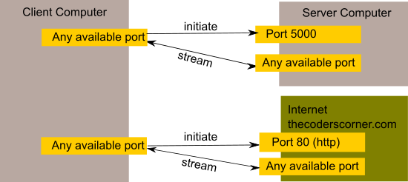
accept()
newfd points to any available port
newfd = accept(fd, peeradr, &peeradrlen);
newfd
newfd

Slide 13
connect()
Function: Initiates a connection to a remote server.
Example in C
#include <sys/types.h>
#include <netinet/in.h>
int fd;
struct sockaddr *peeradr; // @ of server
int peeradrlen; // length of @
int status; // check if the connection is setup successfully.
connect(fd, peeradr, &peeradrlen);
Parameters:
address: A tuple containing the remote server's IP address and port number.

Slide 14
send() or write()
Function: Sends data over the socket.
Example in C
#include <sys/socket.h>
int fd;
int nbytes; // length of data
char *buf; // address of data to be sent
int ndata; // # of bytes actually sent
ndata = write(fd, buf, nbytes);
Parameters:
data: The data to be sent as bytes.

Slide 15
read() or receive()
Function: Receives data from the socket.
Example in C
#include <sys/socket.h>
int fd;
int nbytes; // length of data
char *buf; // address of data received
int ndata; // length of data received
ndata = read(fd, buf, nbytes);
Parameters:
data: The amount of data to receive in bytes.

Slide 16
sendto()
Function: Sends data to a specific destination address using UDP.
Example in C
#include <sys/types.h>
#include <netinet/in.h>
int fd;
int nbytes; // length of data
char *buf; // address of data received
int ndata; // data size sent successfully
int flages; // usually set to zero
int tosdlen; // length of destination @
struct sockaddr *tosd; // destination @
ndata = sendto(fd, buf, nbytes, flages, tosd, tosdlen);
Parameters:
data: The data to be sent as bytes.
address: The destination address (IP address and port).

Slide 17
recvfrom()
Function: Receives data from a specific source address using UDP.
Example in C
#include <sys/types.h>
#include <netinet/in.h>
int fd;
int nbytes; // size of buffer reserved
char *buf; // address of data received
int ndata; // # of bytes received
int flages; // usually set to zero
int fsocklen; // length of source @
struct sockaddr *fromsock; // source @
ndata = recvfrom(sd, buff, nbytes, flags, fromsock, fsocklen);
Parameters:
data: The data received in bytes.

Slide 18
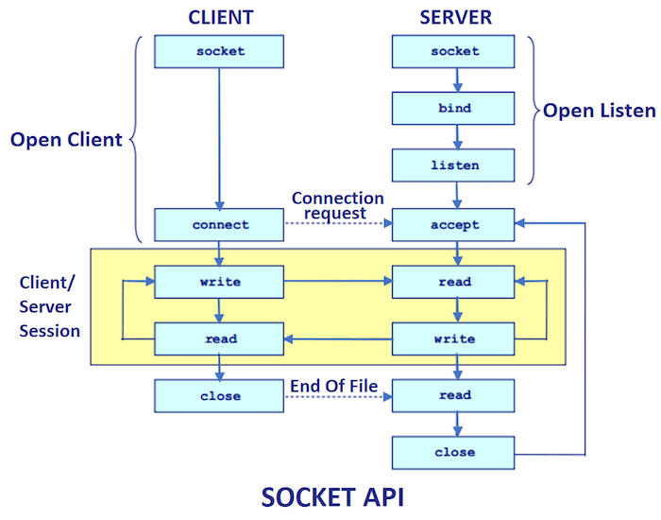
Overview of Socket command calling sequence
Connection services on TCP
Demon server instance is outstanding there await for service request.
Once a connection request is granted, a new process is created along with a new socket for the connection.
The new server process takes over the service to the client.
The demon process goes back and wait for new connection requests.

Slide 19
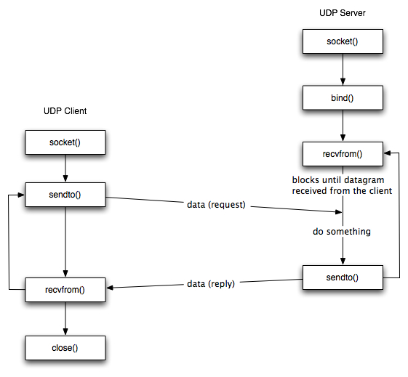
Overview of Socket command calling sequence
Connection services on UDP
Server instance is outstanding there await for service request.
The data requests from all UDP clients are all served by the UDP server instance.
The service work must be simple.

Slide 20
Working with Datagram Sockets
1
Defined Boundaries
2
No Setup Required
Send and receive data in chunks with set boundaries, with each datagram packet containing information on the destination address.
No connection required since there's no listening socket. Both sender and receiver can start communication right away.
3
Less Overhead
Lighter payload as port number and IP address are included in the packet, reducing overall overhead.

